Slide 1

Realizing the Potential of the Power Platform for D365 Finance & Operations
June 17-18, 2020

Slide 2
Mastering Power Automate with Solutions for Finance and Operations

Slide 3

Satish Panwar
Solution Architect
Hitachi Solutions America
@satishpanwar
LinkedIn
satish.Panwar@gmail.com

Slide 4

Sukrut Parab
Technical Architect, MVP
Hitachi Solutions America
@sukrutparab
LinkedIn
parabsukrut1@gmail.com

Slide 5
Power Automate – Why?
Boost Productivity
Quickly and securely automate—at scale
Put intelligent workflows to work
To automate workflows quickly with a no-code/low-code approach

Slide 6
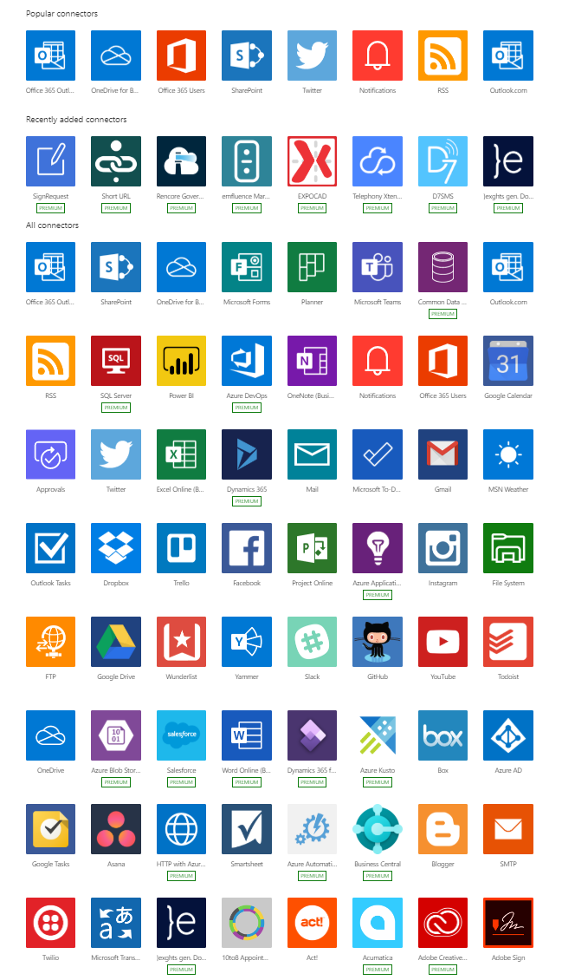
Connector
Standard Connectors

Slide 7

Dynamics 365 for Fin & Ops

Slide 8
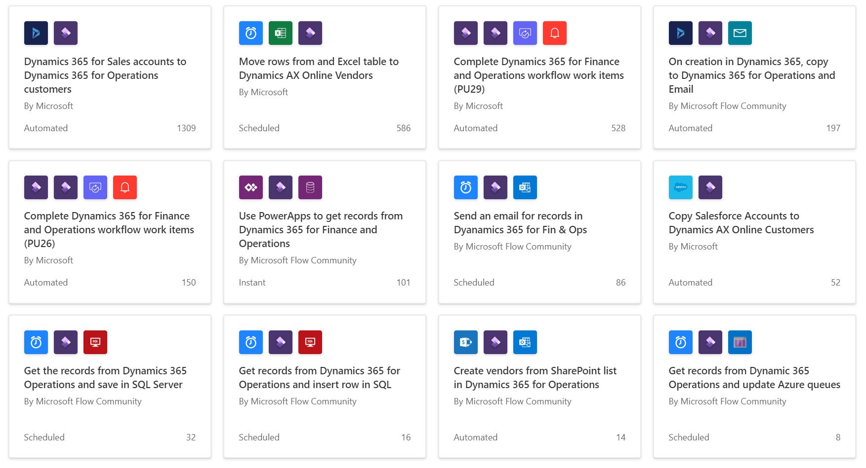
Templates

Slide 9
Triggers
Business Events
Custom Business Events

Slide 10
Triggers
Business Events
Custom Business Events

Slide 11
Actions
Create
Get (Read)
Update
Delete
Get list of entities
Execute

Slide 12
Demo
Create a Record in Finance and Operations

Slide 13
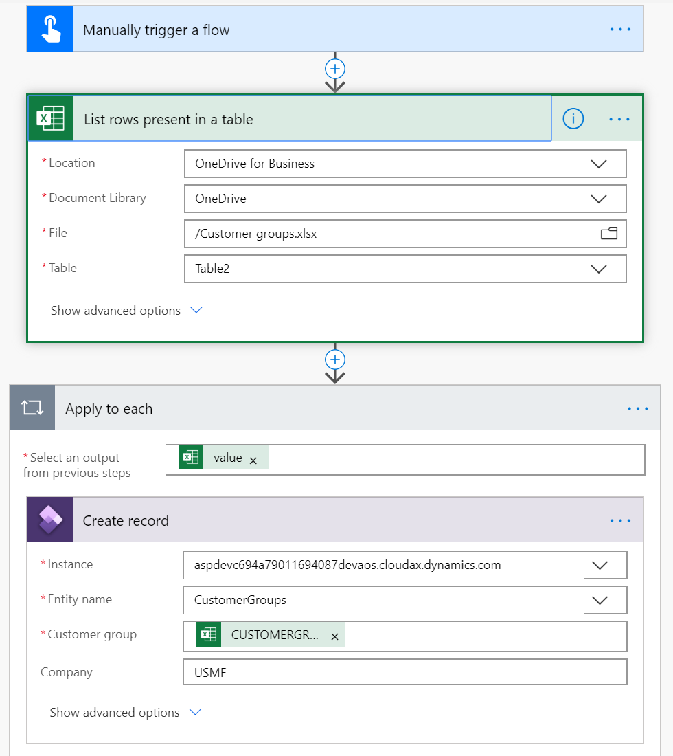
Create Record in Dynamics 365

Slide 14
Data management package REST API
Integrate using Data Packages
Scheduling outside Finance and Operations apps

Slide 15
Scenario
Export Data from D365
Store on OneDrive
Use ExportToPackage REST API

Slide 16
DEMO
https://msdynamicsworld.com/story/how-use-power-automate-extract-data-microsoft-dynamics-365-finance-and-operations-data

Slide 17
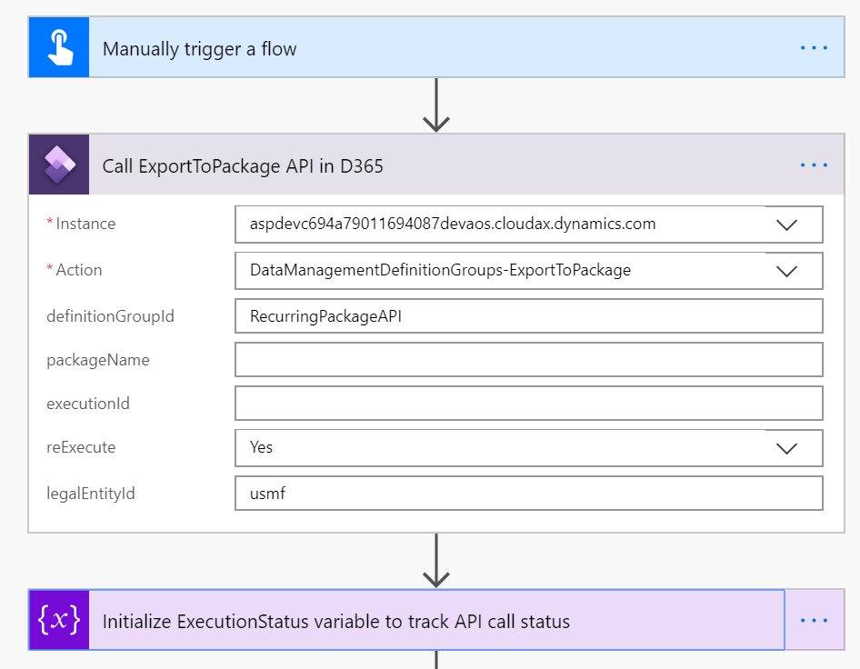
Export to Package - 1

Slide 18
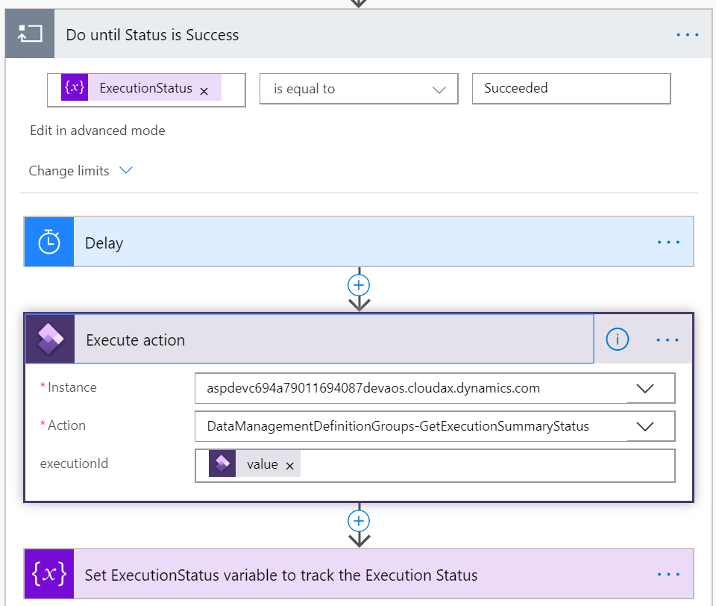
Export to Package – 2

Slide 19
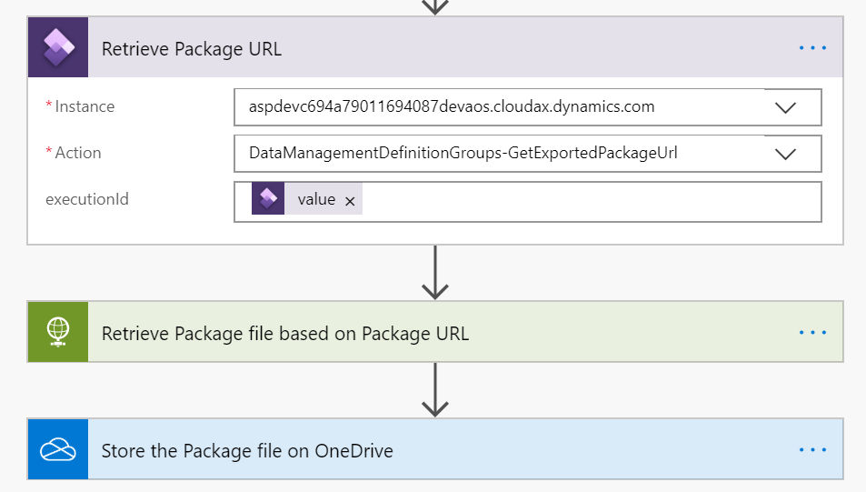
Export to Package – 3

Slide 20
UI Flows

Slide 21
Introduction
RPA feature within Microsoft Power Automate
Helps save time and effort.
Automate manual business processes
Two Flavors
Selenium IDE

Slide 22
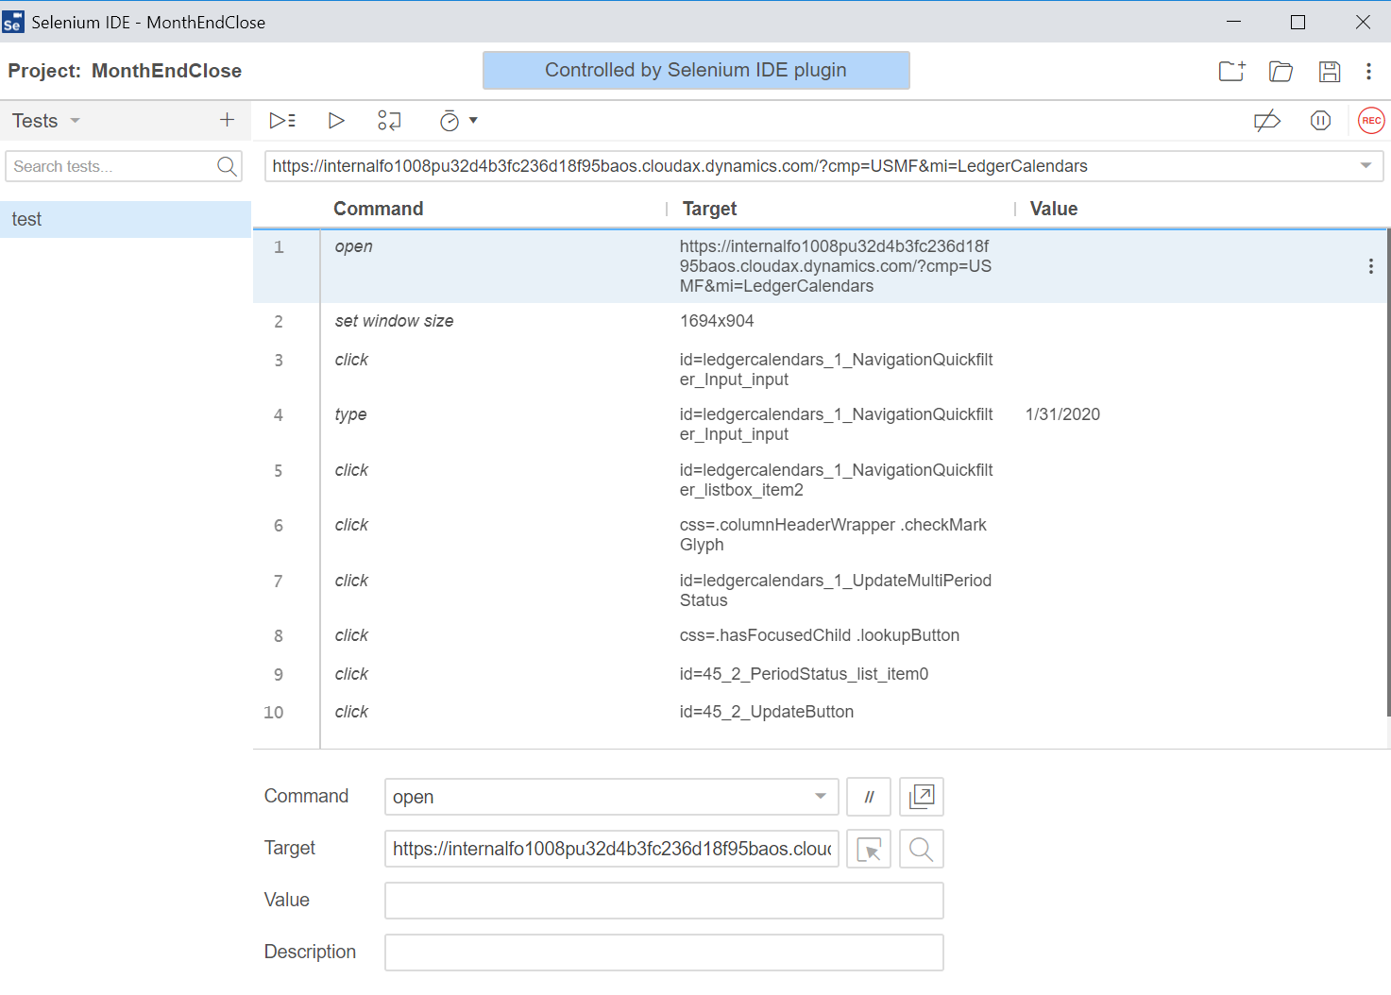
Selenium IDE

Slide 23
Variations
Automate from Flow
Run on the last day of the month at 11pm.
Pass parameters from Power Automate to Web UI Flows
Control Web UI Flows

Slide 24
Demo

Slide 25
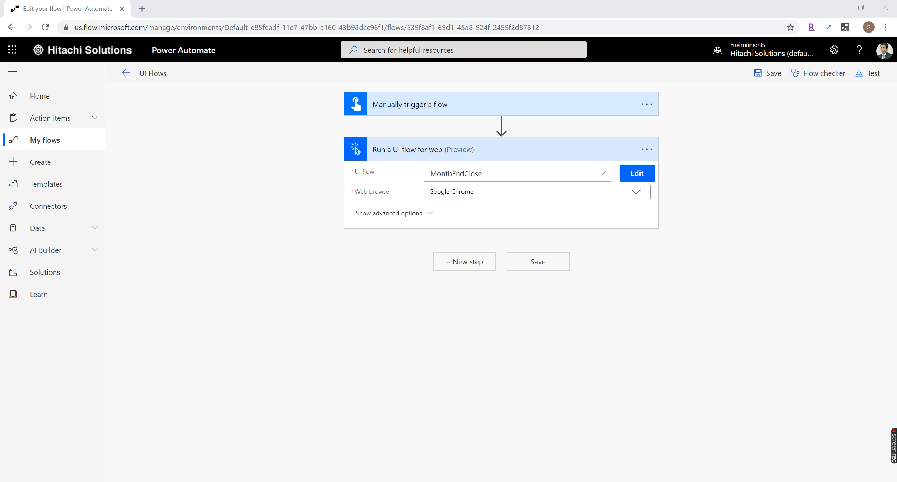
Recorded Capture

Slide 26
Virtual Entities
https://docs.microsoft.com/en-us/dynamics365/fin-ops-core/dev-itpro/power-platform/overview

Slide 27
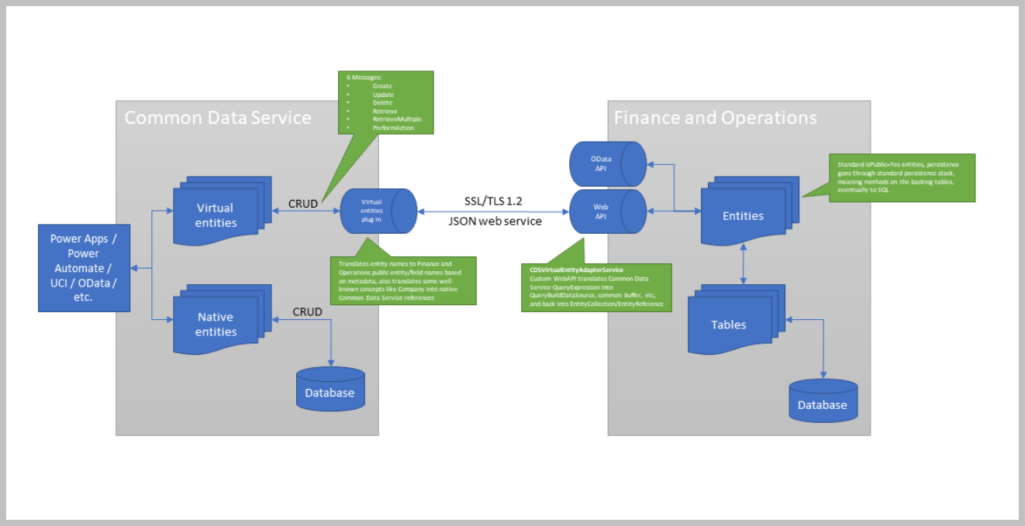
Architecture

Slide 28
Prerequisite
Version 10.0.10 (PU34) with Quality update 10.0.420.10013 (platform 7.0.5600.35528) or later.
CDS environment
No dependency on Customer Engagement applications

Slide 29
Facts
Calculated fields are not supported
Debugging can be done using CDSVirtualEntityAdapter and CDSVirtualEntityController
In CDS entity GUID is primary key
Can not join native and Virtual entities in same query.

Slide 30
Business events

Slide 31
Introduction
Send Notification
Application level trigger
Lightweight and Nimble

Slide 32
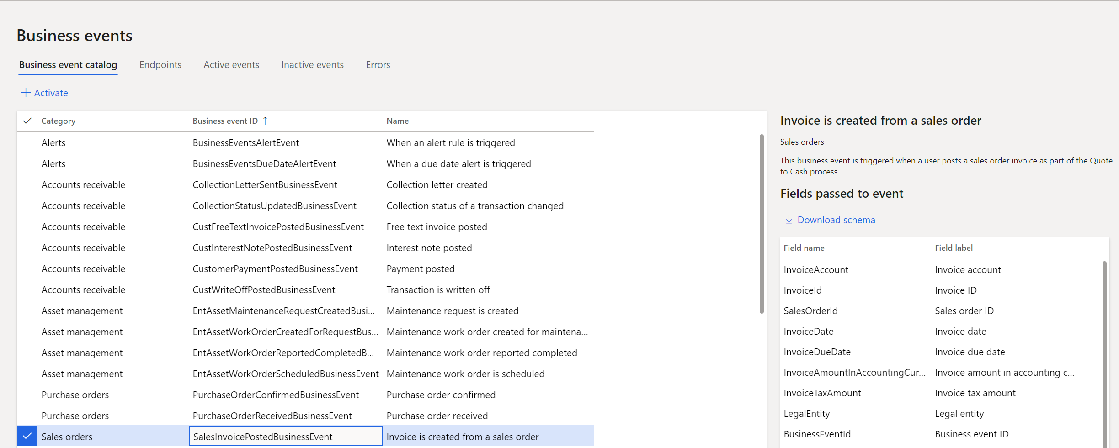
Business Events - 1

Slide 33
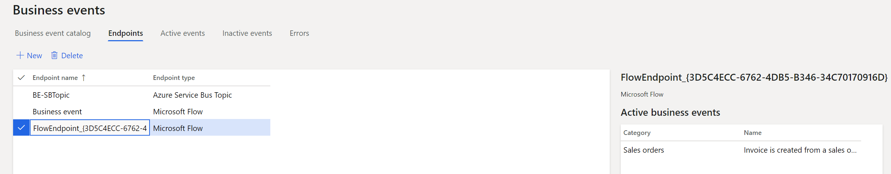
Business Events - 2

Slide 34
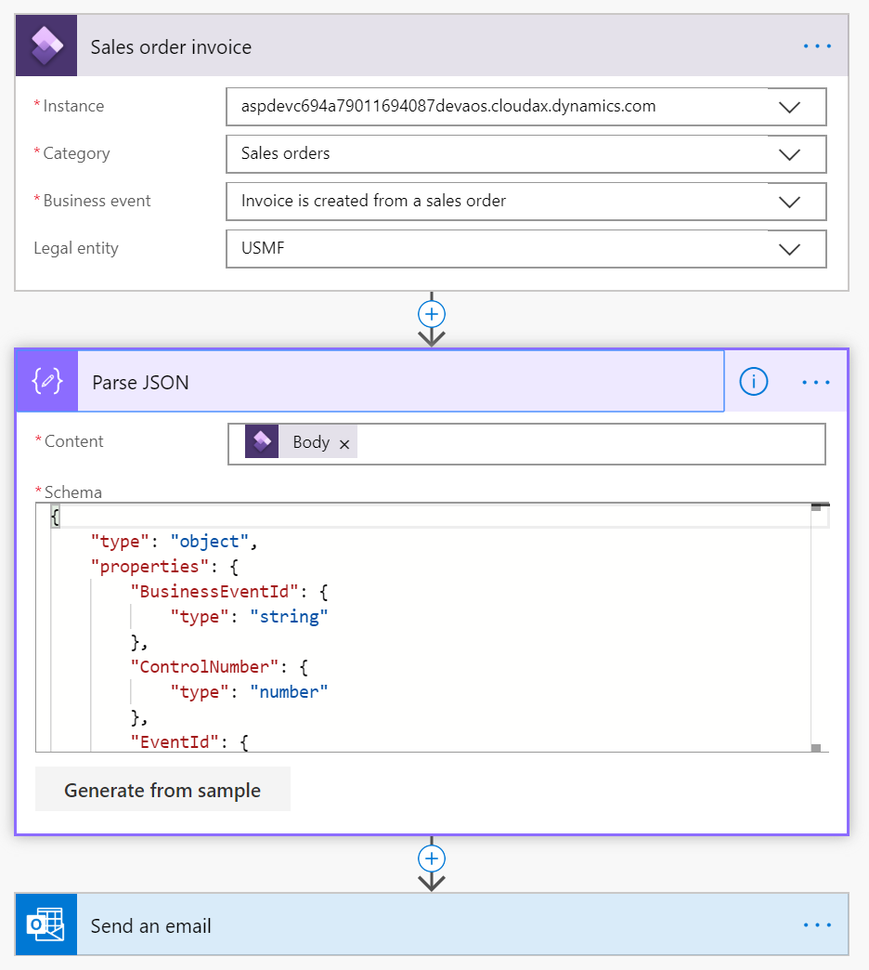
Business Events – 3

Slide 35
Tips
Number Format
Switch from “Integer” to “Number” in payload
Date Format
"2007-12-05T14:30Z" instead of "/Date(1196865000000)/"
https://docs.microsoft.com/en-us/dynamics365/fin-ops-core/dev-itpro/business-events/business-events-dev-doc#adding-human-readable-data-fields-to-the-payload

Slide 36
Tips
Number Format
Switch from “Integer” to “Number” in payload
Date Format
"2007-12-05T14:30Z" instead of "/Date(1196865000000)/"
https://docs.microsoft.com/en-us/dynamics365/fin-ops-core/dev-itpro/business-events/business-events-dev-doc#adding-human-readable-data-fields-to-the-payload

Slide 37
Tips
Number Format
Switch from “Integer” to “Number” in payload
Date Format
"2007-12-05T14:30Z" instead of "/Date(1196865000000)/"
https://docs.microsoft.com/en-us/dynamics365/fin-ops-core/dev-itpro/business-events/business-events-dev-doc#adding-human-readable-data-fields-to-the-payload

Slide 38
Power Apps and Finance and Operations
Using Power Automate

Slide 39
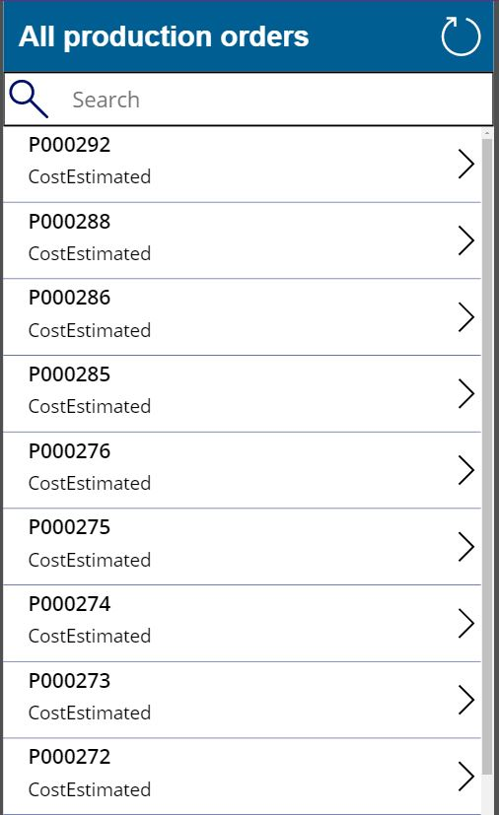
Production order release PowerApp - 1

Slide 40
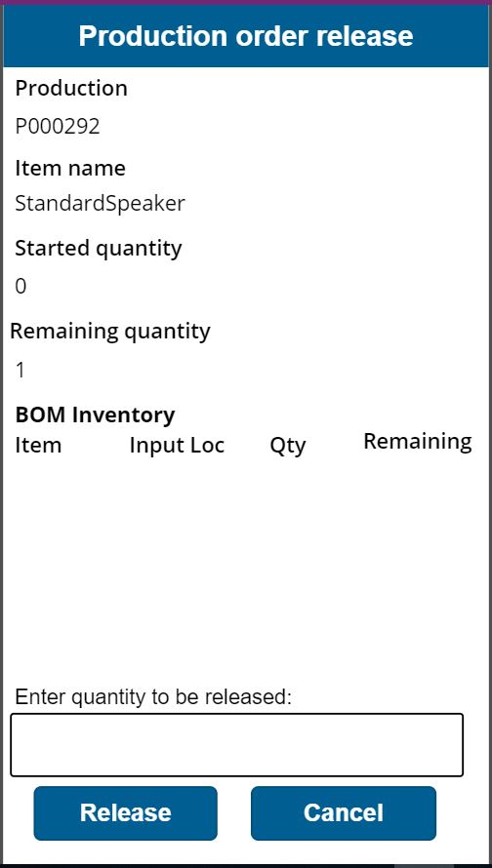
Production order release PowerApp – 2

Slide 41
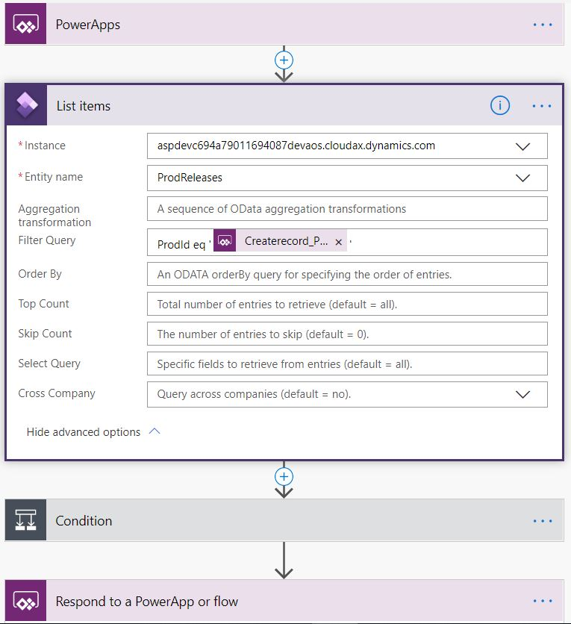
Production order release PowerApp – 3

Slide 42
Questions

Slide 43


